Slide 1

Barber Connect
Alexander Anicete

Slide 2
What is it?
An application where customers and barbers can connect easier than ever in shop or at your home

Slide 3
Why use this app?

Slide 4
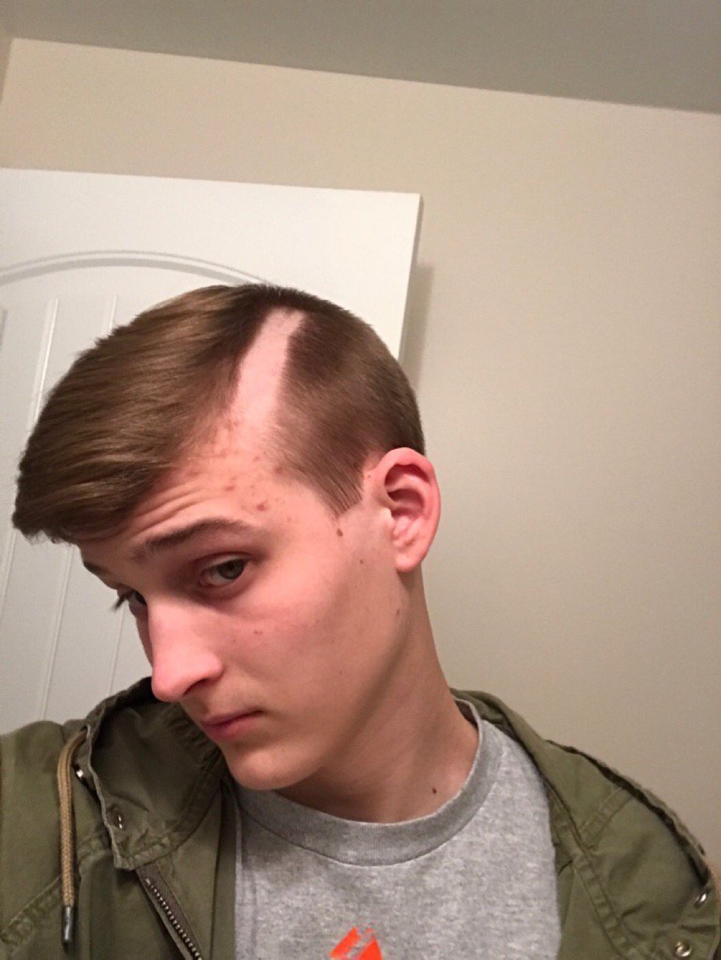
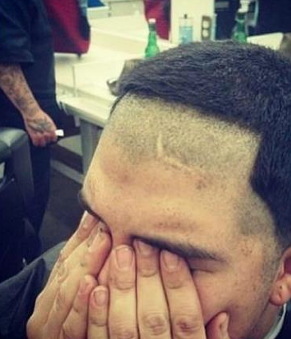

Slide 5
User story (customers)
Easy find credible barbers near your local area
Be able to schedule an appointment even without meeting with barber prior
Not worry about whether or not your barber is trustworthy
Don’t have time or don’t want to go to a barbershop but still wants a fresh cut

Slide 6
USER STORy (barber)
Want to grow customer base
Want to be able to show showcase their work

Slide 7
Features for barbers
Will be able to show off work via pictures
Can easily schedule appointments through app
Update availability on calendar
Give prices ahead of time
Choose whether or not they want to be a barber that works at a shop or at homes or both
Leave reviews for customers

Slide 8
Features for the customer
Customers will be able to search for barbers within their local area
Customers will able to leave reviews based on a comment system and 5 star rating
Customers will be able view schedules for barbers and request for an appointment
Customers will be able to choose if they want to meet barber in a barbershop or at home
Customers will be able to see pricing ahead of time

Slide 9
How
Using asp.net MVC
Sql server
Database for profiles and features of the application

Slide 10
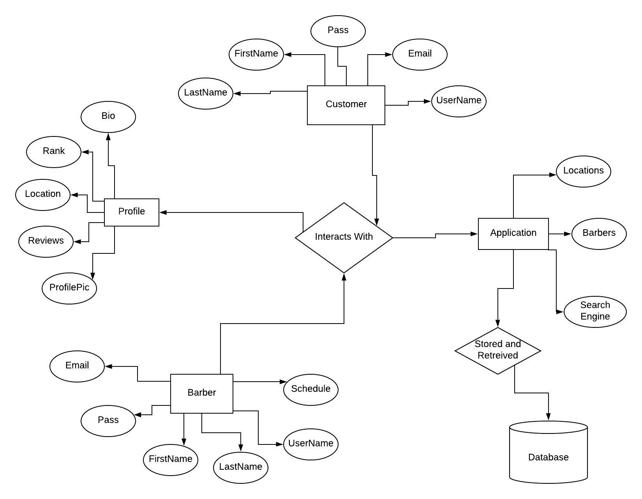
Entity relationship diagram

Slide 11
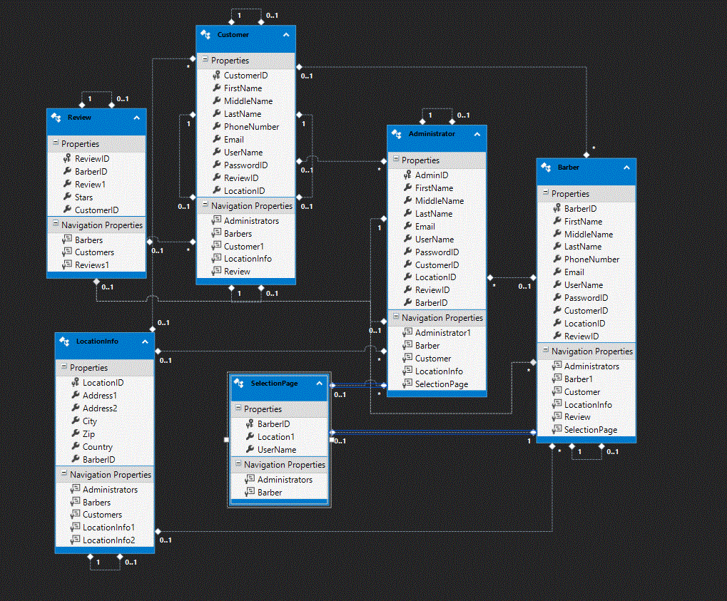
Class diagram

Slide 12
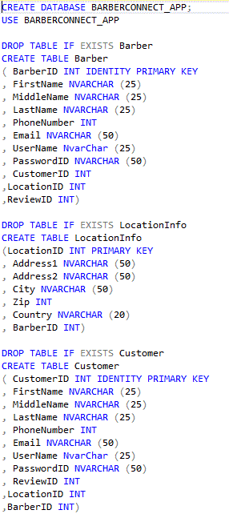
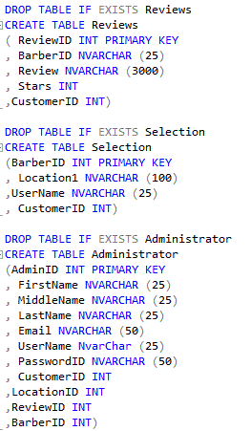
Database scripts

Slide 13
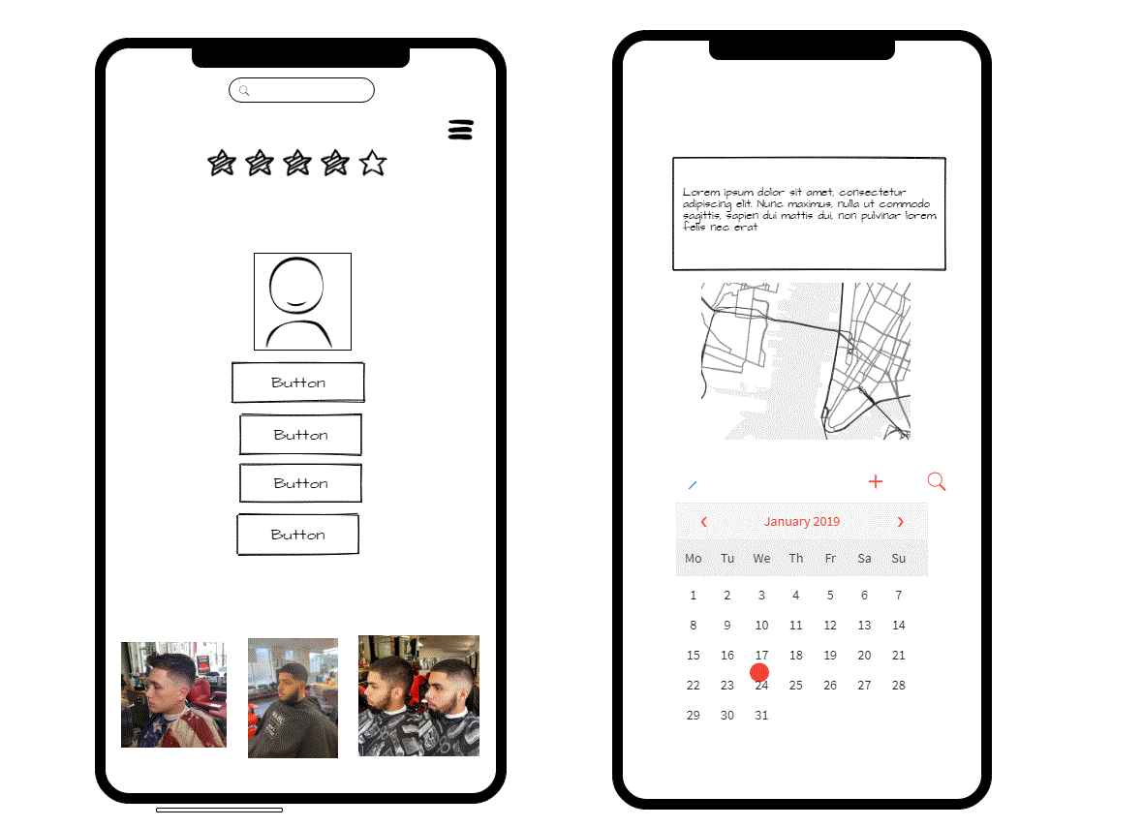
Wireframe

Slide 14
Future plans
Make and receive payments through the app
Used world wide

